Slide 1
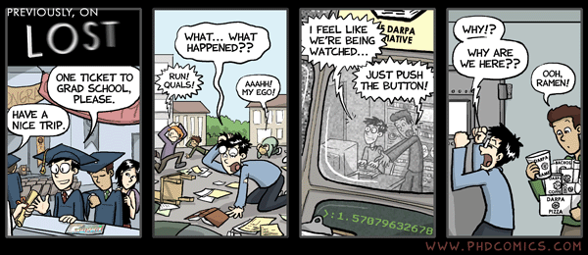
Welcome to UVA CS Grad School Kevin Skadron Department Chair

Slide 2
Overview
Goals of 6190
Provide early guidelines for a successful grad school experience
Survey of cutting-edge research topics
(PhD) Lay foundation for successful PhD research skills
Masters: 1 credit
PhD: 3 credits

Slide 3
Outline
Grad degree programs
Dept. resources
Tips for success
Special considerations for PhD students
Masters research
6190 logistics

Slide 4
Grad School Paths
Masters
Thesis
Typically 2 years
8 courses, plus 6190, plus 6 credits thesis research
Course-based – build skills and competitiveness for good job
10 courses, plus 6190; can include independent study
Research experience very valuable
1-2 years
PhD
5-7 years
Establish credentials as an independent researcher
Typically needed for academic, industry R&D
Masters students can stay for PhD!

Slide 5
Available Channels
Andrew Grimshaw and Alf Weaver, Graduate Program Chairs
Also: bring them handbook ambiguities
Computer Science Graduate Student Group <csgsg@cs>
Current contact: Elahe Soltanaghaei, <e.soltanaghaei@gmail.com>
Kevin Skadron, Dept Chair
Jan Cornell, Debbie Rose, and Kim Gregg, Administrators
Wendy Morris, Fiscal Tech
Gabe Robins, ombudsman

Slide 6
Graduate Ombudsman
om·buds·man (ŏm'bŭdz'mən, -bədz-, -bʊdz'-)
n. One who investigates complaints and mediates fair settlements, especially between aggrieved parties such as consumers or students and an institution or organization
Please go to ombudsman with complaints or questions
Trouble talking to your advisor? Complaints about quals? Don't know where to take another question?
Ombudsman can keep your comments anonymous
Also feel free to discuss with graduate program chairs and/or dept. chair

Slide 7

The members of the department envision an environment where a diversity of capable, inspired individuals congregate, interact and collaborate, to learn and advance knowledge, without barriers. We embrace this vision because:
We wish to be leaders and role models in reaping and sharing the benefits of diversity.
We seek to improve the intellectual environment and creative potential of our department.
We expect to produce happier, more capable and more broadly educated computer science graduates.
We wish to contribute to social justice and economic well being for all citizens.
We wish to be accountable for these goals!

Slide 8

A Brave New World
Grad school, and life, are fundamentally different from UG
Transition from doing what you're told to thinking on your own
Each student transitions differently
Each advisor encourages the transition differently
To succeed in courses and research, you must think for yourself
Too much to read, learn and study; you can rarely know all you need to know to take the next step—develop good intuition

Slide 9

Common Pitfalls
Thinking that you know what you want to do.
Be open minded: education should change you.
Trying to be good at everything.
Just do a few things very well.
It's just about me.
To survive, you must get involved: attend talks, meet with faculty candidates, participate in student groups, show initiative.

Slide 10
Challenges
Different expectations for a grad student
Lack of direction (the never-ending thesis)
Feeling isolated or unsupported
Difficulties with advisor, other students, etc.
Anxiety about getting through successfully
Unexpected personal problems or conflicting life commitments
Funding constraints or financial difficulties

Slide 11
Responsibility
1. Be proactive – take responsibility for your own grad school experience
Think about what you really want from graduate school, and identify opportunities to attain those goals
Continue the mental transition from being told what to do, to deciding what to do
Don’t wait for faculty members to come to find you: take the initiative to build relationships

Slide 12
Know The Faculty
2. Establish positive relationships with your advisor and members of your committees
Schedule regular meetings with your entire PhD committee once you form it: at least once a year
Have a clear purpose for each meeting, and communicate the agenda in advance to your advisor and committee
Follow up on items discussed in meetings; keep your advisor informed of your progress and challenges
Act as a junior colleague: ask questions, advance ideas, show interest and support for shared goals

Slide 13
Collaborate
3. Embrace your academic community
Seek input and collaboration from faculty members and your peers; don’t isolate yourself
Attend optional seminars and lectures within the CS department
Attend and present at conferences
Begin thinking of yourself as a member of your profession and academic field

Slide 14
Have Fun!
4. Seek balance and support in your life
Remember that you have friends and family outside of grad school.
Seek out the many resources at UVA that can help you through the tough times.
Remember that this will be among the most inspiring and satisfying times in your life: the Job Of Ultimate Mastery.
Researchers have correlated adequate sleep, exercise, and healthy diets with critical analysis, innovation, and economy of effort.

Slide 15
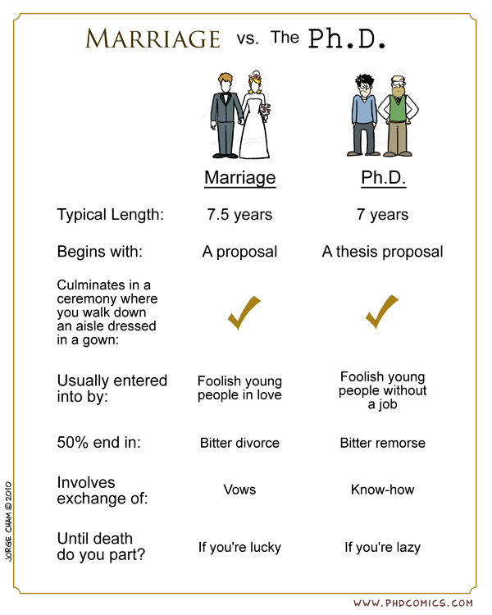
Advisor Selection
Students often rank “research area” too highly
Sign up for classes with potential advisors
Wow them on the semester project
If no class is available: send them email

Slide 16
Rotations
PhD students rotate through one or more research groups before finalizing an advising match
First year broken into rotations of 10, 12, 10 weeks
Goals
Find a good match of advising style and research area interest
Maybe find co-advisors!
Learn about different advising styles and research areas
Learn new research skills
Get excited about research!

Slide 17
More on Rotations
First rotation was assigned based on faculty input
No obligation!
Second/third rotations will be assigned through a matching process
Can opt to do multiple rotations with same advisor

Slide 18
Quals
Breadth: 6 courses across 4 areas
Depth: Research project, paper, defense
Typically in 2nd year

Slide 19
Random Hints: Committees
You will need committees (groups of agreeing faculty members) for
The Quals/Project Presentation (which also nets you the MCS degree)
The MS Defense
The Ph.D. Proposal
The Ph.D. Defense
Much overlap is possible
Considerations:
Faculty views on “right way to do things”
Ease vs. critical feedback
Letters of reference later
Ask around for the inside
scoop.

Slide 20
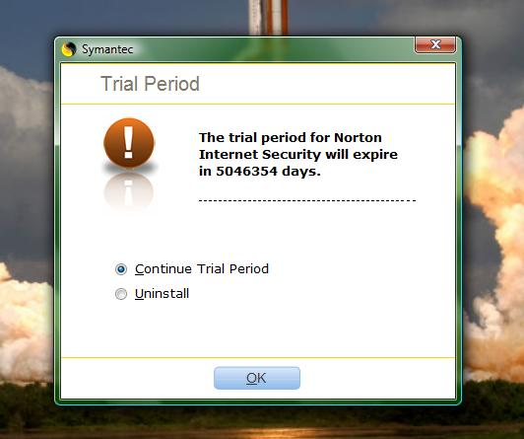
Time In Grad School
PhD career will probably span six years
1st year – Rotations
2nd year – RA, quals, obtain MS/MCS, 1 paper
2nd summer – internship, 2 papers
3rd year – RA, PhD proposal, 3 papers
3rd summer – internship? journal?
4th year – RA, PhD work, 4-6 papers
5th year – RA, PhD work, 5-8 papers
6th fall – job applications
6th spring – graduate

Slide 21
Masters Research
A research project gives you a major independent project, maybe also software releases, publications
Very helpful for interviewing for jobs and applying for PhD programs
Credit or pay
Need to find a research advisor

Slide 22
6190 logistics
Masters students (1 credit hour)
Several lectures on grad school/career success
Attend 12 faculty research days (usually 2 faculty per day)
Attend 6 external-speaker colloquia
PhD students (3 credit hours)
Attend all faculty talks/colloquia
Also evaluated on research progress in first rotation
Miss no more than two sessions
Attendance – sign-in sheet (honor code)

Slide 23
Questions?

